Slide 1
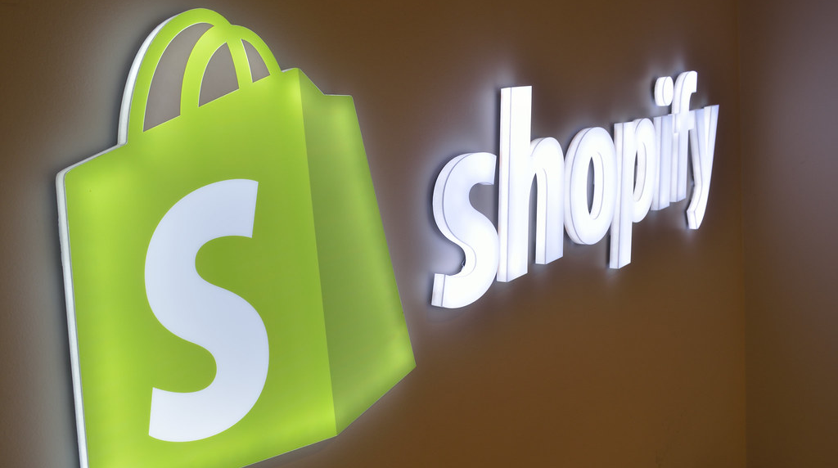
A Comprehensive Company Overview
Muskan Malik
Vanshika Goel
Artin Rismanchi
Isaac Abheek
Chun Yin, Ko (Edwin)
Honglin Wang
Ni Zeng

Slide 2
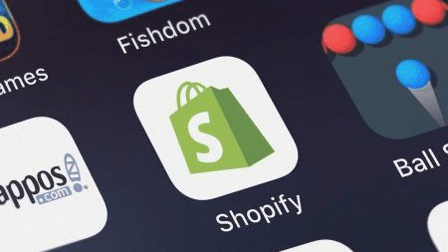
Company Mission
"Making commerce better for everyone"
This Photo by Unknown author is licensed under CC BY-SA-NC.

Slide 3
Table of Contents
Brief overview on Shopify and its associated industry
1
Macroeconomic analysis
2
Impacts of macroeconomic environment on Shopify and industry
3
Construct an appropriate DCF Model on Shopify
4
Determine whether Shopify is overvalued, undervalued, or fairly valued

Slide 4
History of Shopify
2004
Origin
2006
Launch services to public
2009
App store & API
2010
First contest
2013
Shopify payments
2015
IPO
Today
Shopify is the 3rd most valuable company in Canada
2022
10 : 1 stock split
Notes:
This timeline showcases Shopify's evolution from a small startup to a leading player in the e-commerce space, highlighting major growth and expansion milestones.
Shopify was originated in 2004
Two years after its inception, Shopify officially launched its service to the public.
Five years into its journey, Shopify expanded its capabilities by launching an app store and an application programming interface (API), allowing third-party developers to create apps and integrations for Shopify stores.
Shopify hosted its first contest in 2010, likely to encourage developers to build on its platform and to attract new merchants.
In 2013 Shopify introduced its own payment processing system, making it easier for merchants to accept payments.
In 2015 Shopify went public, listing its shares on the stock market through an Initial Public Offering (IPO). With a stock price of USD17 per share
In 2022 Shopify implemented a 10-for-1 stock split, from approximately $350 to $35
As of the date Shopify is recognized as the third most valuable company in Canada, standing at 132 billion dollars.

Slide 5
Overview
Core Business and Services
Key Business Solutions
E-commerce platform.
Range of services.
Merchant Solutions
Subscription Solutions
Notes:
Core Business and Services
Shopify's core offering is its e-commerce platform, enabling businesses to set up online stores and sell products across various channels, including web, mobile, social media, and physical locations.
The platform offers tools for managing products and inventory, processing orders and payments, shipping, marketing, customer engagement, and analytics.
Key Business Segments:
Subscription Solutions includes revenue generated from merchants subscribing to Shopify's platform. It offers various plans tailored to different business sizes and needs, providing tools for website creation, product management, sales channel integration, and analytics.
Merchant Solutions encompasses a range of additional services offered to merchants. These include payment processing through Shopify Payments, logistics, shipping solutions via Shopify Shipping, and merchant cash advance and loan services through Shopify Capital.

Slide 6

Target Market
Entrepreneurs – Ability to start up a business with little startup costs, knowledge, or risk.
Business owners – Lightens existing business costs. Easy way of transferring business model from brick and mortar to digital
Influencers- Allows influencers to sell their products and merchandise to fans.
Notes:
Target Market," focuses on Shopify's core customer segments. It identifies three main groups: entrepreneurs, business owners, and influencers. Entrepreneurs are drawn to Shopify for its low startup costs and minimal risk. Business owners appreciate the platform for reducing existing business costs and its ease of transitioning from a traditional model to digital operations. And Influencers use Shopify to monetize their audience by selling products and merchandise.

Slide 7
Industry Analysis
E-Commerce Trends- Post Pandemic shifts
Competitive Landscape
Consumer Preferences
Technological Integration
Notes:
I"Let's begin with the E-commerce trends and post-pandemic shifts. The pandemic has undeniably accelerated the move towards online shopping, a trend that's here to stay. For companies like Shopify, this is excellent news. The sustained shift toward e-commerce is not just a temporary blip but a fundamental change in consumer behavior. This continuing trend is a strong tailwind for Shopify, supporting robust revenue growth projections for the foreseeable future."
"Moving on to the competitive landscape. The e-commerce arena is fiercely competitive, and Shopify is right in the thick of it. To maintain or even grow its market share, Shopify must heavily invest in marketing and innovation. However, it's important to note that these investments, while crucial, will impact the company's operational costs. Balancing growth with profitability will be key."
"Next, let's talk about consumer preferences. Today's consumers are seeking more personalized shopping experiences. This growing demand is pushing companies like Shopify to invest in technology that can offer such personalization. While this will influence capital expenditure projections, it's an investment that can significantly enhance customer engagement and loyalty."
"Our final point is on technological integration. We're witnessing an increasing adoption of advanced technologies like AI, AR, and VR in e-commerce. For Shopify, investing in these technologies might mean higher short-term costs. However, the potential long-term gains are immense. These technologies can not only help in gaining a larger market share but also in building a more loyal customer base."

Slide 8


Competitive analysis- Direct Competitors
SaaS | Yes | Yes | No
Beginning Price Structure | $29/month | $29.95/month | Free
Number of Templates/Themes | 1000 | 12-free 158-paid | 11
Ease of Use | Easy to Use | Easy to Use | Learning Curve
Free Trial | Yes | Yes | N/A
Notes:
Let's focus our lens on Shopify and how it stands in the competitive e-commerce platform market.
Shopify distinguishes itself through its SaaS model, ensuring that it's not just a product but a comprehensive service platform.
With a beginning price of $29 a month, Shopify is positioned as a cost-effective solution for businesses of all sizes.
It offers a remarkable range of over 1000 templates, simplifying the setup process and providing users with numerous options to tailor their online presence.
Ease of use is where Shopify truly shines. It's designed for entrepreneurs who want to focus on their business, not on learning complex software. This user-friendliness is complemented by the option of a free trial, allowing users to explore the platform's capabilities without upfront investment.
When we compare Shopify to its competitors, we see a platform that balances affordability with functionality, making it an attractive starting point for businesses embarking on their e-commerce journey.

Slide 9

Competitive analysis- Indirect Competitor
Features
Type of Business | Large-scale online retailer | Platform for creating online stores
Marketplace | Hosts a marketplace for third-party sellers | -
Product Range | Wide range of products | -
Unique Offerings | Prime membership benefits | Tools for website, payment, marketing
Logistics and Fulfillment | Efficient logistics and fulfillment | -
Target Audience | Target end customers | Focuses on small to medium businesses
Control Over Operations | - | Provides control over operations and branding
Direct Selling | Yes | Does not sell products directly
Business Focus | - | Empower merchants with easy- to-use tools
Notes:
In this slide, we see a clear distinction between Shopify and Amazon.
Shopify stands out as a platform dedicated to enabling businesses to create their own online stores,
offering control and a suite of tools for:
1. website management
2.payment processing
3. and marketing.
It's designed with the focus on small to medium-sized businesses, seeking to give them a strong start in e-commerce without the complexities of direct selling.
Amazon, on the other hand, acts as a :
1.vast marketplace for a wide array of products,
2. targeting end customers with efficient logistics.
In essence, Shopify provides the infrastructure for businesses to build and grow their e-commerce presence independently.

Slide 10
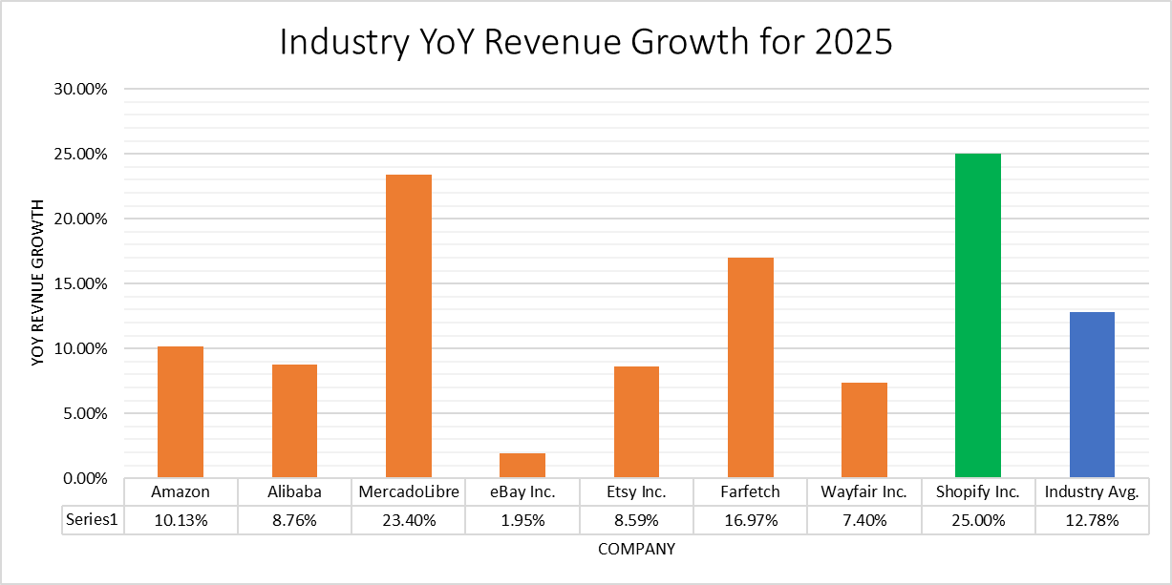
2025 Bloomberg Est.
Notes:
So this bar chart shows us the 2025 estimate for revenue growth of shopify and its competitors.
The industry avg is estimated to be 12.78% and shopify is beating it by 12.22%.
Amazon revenue growth is going be 10.13%, Alibaba at 8.70%
Mercadolibre is a close competitor at 23.4% followed by Farfetch at 16.97%.

Slide 11
Shopify Market share in 2024 ( at glance)
Countries | Total Websites | Percentage share in Shopify Websites
United States | 2,681,566 | 62.21%
The United Kingdom | 189,147 | 4.38%
Australia | 136,581 | 3.16%
Brazil | 121,168 | 2.81%
Germany | 107,726 | 2.49%
Shopify ranks 4th among the top 5 eCommerce platforms worldwide, with a market share of almost 11%.
Shopify owns 28% of the e-commerce platform market share in the United States.
The market capital of Shopify is 98.23 billion as of Jan. 31, 2024.
Notes:
Let's take a quick look at Shopify's market share as of 2024.
Shopify has solidified its position as the fourth largest e-commerce platform globally, holding an impressive 11% of the market. But it's in the United States where Shopify truly dominates, with a commanding 28% share of the e-commerce platform market.
The numbers speak volumes about Shopify's impact. In the U.S. alone, there are over 2.6 million websites powered by Shopify, which accounts for a staggering 62.21% of all Shopify websites worldwide. This is a testament to Shopify's robust platform and its ability to meet the diverse needs of American businesses.
The United Kingdom, Australia, Brazil, and Germany also show significant adoption, with Shopify underpinning a substantial portion of e-commerce activities in these countries.
This global footprint is reflected in Shopify's market capitalization, which stands at an impressive $98.23 billion as of the second quarter of 2023.
What we're witnessing here is not just growth but a global movement as more businesses turn to Shopify to build their e-commerce presence.

Slide 12
Macroeconomic Analysis
Economic Indicators
Rate of Inflation
Risk Free Rate
Notes:
Macroeconomic Analysis
Global Economic Trends:
Recessions and Economic Booms: Economic downturns typically lead to reduced consumer spending, which can negatively impact e-commerce sales. Conversely, during economic booms, consumer confidence and spending usually increase,
potentially boosting Shopify's growth. Financial projections should account for these cyclical economic patterns.
Inflation and Purchasing Power: Rising inflation can erode consumer purchasing power, affecting online sales. This aspect can be factored into projections by
moderating revenue growth during high inflation periods.

Slide 13

Economic Indicators
Rate of Inflation:
When inflation is high, consumers experience reduced purchasing power, and their ability to buy goods and services becomes limited
This can lower the demand for products sold by businesses on the Shopify platform
High inflation also results in higher expenses and COGS
Inflation rate is used to estimate the growth of expenses within the DCF model
Risk Free Rate:
Decrease in interest rates has been associated with an increase in consumer spending
Low interest rates stimulate economic activity by lowering the costs of borrowing and investing for businesses
This environment is particularly advantageous for Shopify's target clientele (small to medium-sized enterprises)

Slide 14
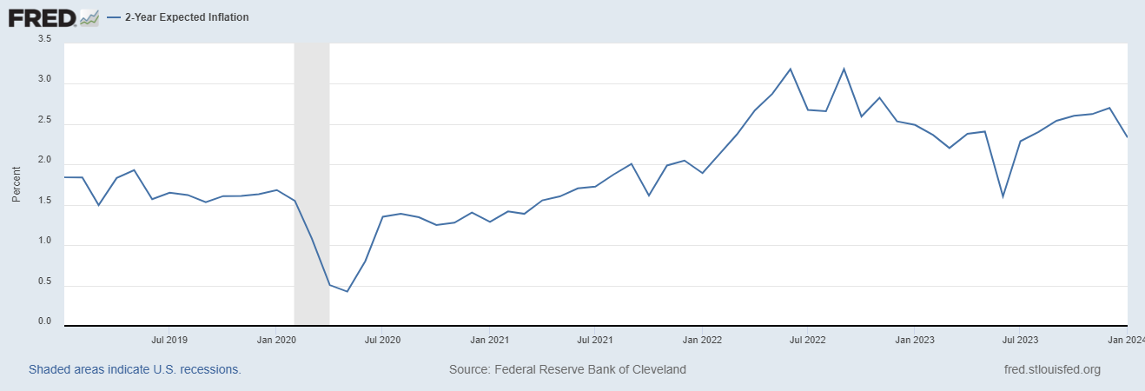
Short-term Inflation Rate
Anticipate elevated levels in short-term inflation at 2.33%
Source: FOMC Summary of Economic Projections | Bull Case | Base Case | Bear Case
Short-term PCE inflation | 2.00% | 2.33% | 2.40%

Slide 15
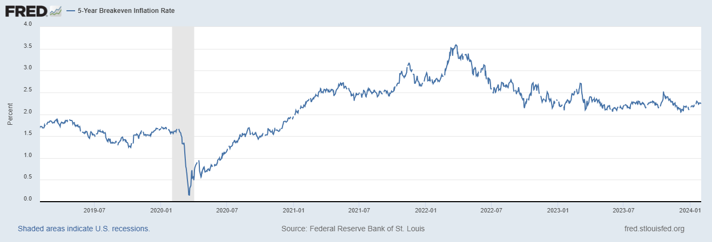
Medium-term Inflation Rate
Anticipate modest levels in medium-term inflation at 2.29%
Source: FOMC Summary of Economic Projections | Bull Case | Base Case | Bear Case
Medium-term PCE inflation | 2.00% | 2.29% | 2.35%

Slide 16
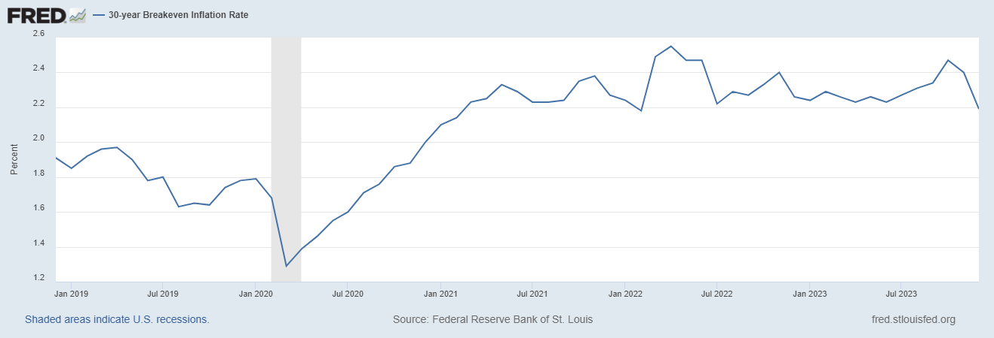
Inflation Rate in the Longer Run
Anticipate steady levels of inflation in the longer run at 2.19%
Source: FOMC Summary of Economic Projections | Median | Range
Longer run PCE inflation | 2.00% | -

Slide 17
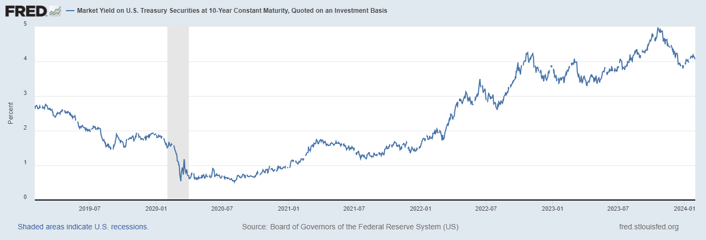
Risk Free Rate
As of January 29, 2024, yield on US 10 Year Treasury Bond is 4.02%
Expect at least a decrease of 50bps by the end of 2024
Short-term risk free rate used to estimate WACC & cost of borrowing is 3.50%
Source: FOMC Summary of Economic Projections | Bull Case | Base Case | Bear Case
Long-term risk free rate | 2.40% | 2.50% | 3.8%

Slide 18
Shopify’s
Ongoing Strategies
Financial Activities

Slide 19

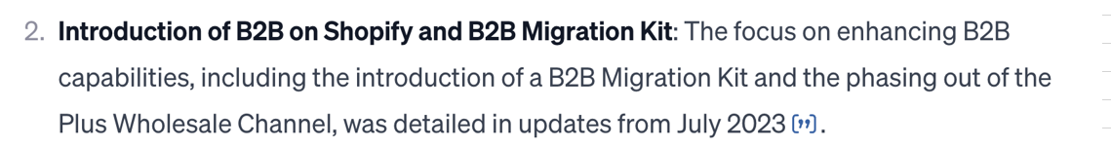
Ongoing Strategies
Cutting Logistic Business
Marketplace Connect
AI Development
Partnership with Social Media
Financial Solutions and Fintech Development
Price Updating
B2B Development
Retail Plan
Notes:
Here are some main strategies that Shopify is focusing for the recent 1 to 2 years, and they are still emphasized in the recent Q3 report from Shopify as their future essential strategies.

Slide 20
Ongoing Strategies
Cutting Logistic Business
May 4, 2023: Shopify sold its logistics business to Flexport, making Flexport the preferred logistics partner.
This move reduced Shopify's size by about 20%, lead to workforce reduction.
Operating Expense (General and administrative)
Financial Solutions and Fintech Development
April 24, 2023: launch of Shopify Bill Pay,
It’s a tool for merchants to manage and pay vendors directly within Shopify.
This may enhance Shopify's fintech offerings, streamline vendor payments within Shopify, and increase its transactional revenue streams.
Revenue (Merchant)
Operating Expense (R&D, Transaction and loan losses )
AI Development
July 26, 2023: launch of AI-enabled features (Shopify Magic) and Sidekick (will be available in early access soon):
Unveiling nine new Shopify Magic features.
Introducing Sidekick as the centerpiece of Shopify Magic.
Operating Expense (R&D)
June 27, 2023: Bret Taylor joined Shopify’s board of directors, bringing expertise in enterprise and AI from his time as co-CEO of Salesforce.
Retail Plan
August 2023: since launched in early August, merchants subscribing to this plan has contributed to 16% of their Point of Sale (POS) growth.
support up to 1000 retail locations for merchants.
Revenue (Subscription, Merchant)
Operating Expense (General and administrative, Sales and marketing)
Notes:
1. In May 2023, Shopify cut their logistic business, reducing their size by 20%. This may impact their future general and administrative expenses.
2. Shopify also emphasis their research and technology development a lot. They kept improving their financial solutions and fintech, facilitating their merchants, and in turn help themselves to improve revenue.
3. AI is another big focus for Shopify this year. They developed nine new features for their AI-enabled features Shopify Magic. And a new tool sidekick will also be available soon.
>>> 2. 3.
These technology development will increase Shopify’s R&D expenses but may decrease the transaction losses, and also bring them merchant revenues.
4. Except for these, Shopify has been enhancing features for retail stores, especially those integrated with Shopify's Point of Sale (POS) system. Shopify has supported up to 1000 retail locations for merchants, and this number will continue to expand in the future, increasing Shopify’s administrative and marketing expenses, but also increase their subscription and merchant revenue.
Cutting Logistic Business:
could affect their revenue structure and operational expenses.
Retail plan: This update streamlined the user experience and improved performance in managing locations, alongside significant API enhancements for large-scale operations
point-of-sale (POS) solutions that allow businesses to sell in physical retail locations using their platform, the focus is on helping merchants with both online and offline sales.
In 2023, in its Q3 report Shopify again emphasized its attention and continuous effort to these fields.

Slide 21
Ongoing Strategies
Partnership with Social Media
July 2022: partnership with YouTube
October 2021: launched a new Spotify channel
October 2020: developed partnership with TikTok
Revenue (Subscription, Merchant)
Operating Expense (General and Administrative, Sales and marketing)
Price Updating
January 2023: increased prices of subscription plans by 30%. This is the first major pricing change in 12 years.
Affected subscription revenue and merchant retention.
Revenue (Subscription)
B2B Development
June 2022
Start expanding into the wholesale market.
Partnered with Faire, a leading wholesale marketplace.
Broadened its offering from DTC to B2B; increased its Gross Merchandise Volume (GMV) in the B2B sector; connected Shopify merchants with Faire retailers.
Revenue (Subscription, Merchant)
Operating Expense (General and Administrative, D&R, Sales and marketing)
Marketplace Connect
Shopify Editions Summer 2023:
merchants can connect and sync data with marketplaces like Walmart, Amazon, eBay, etc., through the Marketplace Connect app.
Revenue (Subscription, Merchant)
Operating Expense (General and Administrative, D&R, Sales and marketing)
Notes:
Shopify has cooperated with major social media platforms, including YouTube, Spotify, TikTok. Such cooperation will keep expanding and contribute to Shopify’s subscription and merchant revenue.
Another important aspect is that Shopify has increase their subscription price in 2023 by 30%. This is their first major pricing change in the past 12 years. We assume this will increase their subscription revenue.
B2B and wholesale market is also a main focus for the future years. Although these expanssion will increase the cost of administration, R&D, and marketing; it potentially increases revenue as well.
In addition, connecting merchants with major marketplaces brings positive effects for the revenue. During this process, administration, R&D, and marketing expenses may also increase.

Slide 22
Ongoing Strategies
revenue-related
expense-related
Partnership with Social Media
AI Development
Cutting Logistic Business
Financial Solutions and Fintech Development
Price Updating
Marketplace Connect
B2B Development
Retail Plan
Notes:
We put these strategies into different categories and used them as a facility to build up our DCF model.

Slide 23
Financial Activities
Principal Cash Requirements​
For working capital and capital expenditures; working capital on September 30, 2023, was $5.6 billion.​
Strong liquidity position
Cash Management Program (Sep 2023)​
Cash, cash equivalents, and marketable securities totaled $4.9 billion, held for operations, working capital, and capital preservation purposes.​
Holding a large amount of cash and equivalents for operations
Strategic diversification and potential for future equity conversion
Issuance of Notes (Sep 2020)​
Invested $200 million in a private company through the purchase of convertible notes.​
Issued $920 million aggregate principal amount
of Notes with a fixed annual interest rate of 0.125%.​
The fixed interest rate on the issued Notes minimizes interest rate risk
Issuance of Notes (Sep 2020)​

Slide 24
Financial Activities
Cash and Marketable Securities (Sep 2023)​
Decreased by $135 million to $4.9 billion from $5.1 billion as of December 31, 2022.​
Suggests a reduction in liquid assets
Financing Operations​
Primarily through the sale of equity securities and the sale of Notes, raising approximately $7.8 billion net of issuance costs.​
Filing of a new short-form base shelf prospectus allowing Shopify to offer an unlimited amount of Class A subordinate voting shares, preferred shares, debt securities, warrants, subscription receipts, units, or any combination thereof during a 25-month period starting September 9, 2022.​
Increase in shareholder equity dilution and debt burden.
Shelf Prospectus (Sep 2022)​
Financing Activities (9 months ended Sep 2023)​
Net cash provided by financing activities due to proceeds from the issuance of Class A subordinate voting shares and Class B restricted multiple voting shares as a result of stock options exercises.​
Equity and Other Investments (Sep 2023)​
Equity and other investments in public and private companies totaled $3.7 billion.​
Introduces market risk

Slide 25
Financial performance and proforma
Historical Figures
DCF Model
Financial Assumptions
Notes:
Assumptions about sales growth can be based on global economic trends and Sales Growth trends, technological adoption rates, and expansion strategies.
Operational Costs: Assumptions should include potential increases due to investments in technology, marketing, and compliance with regulations.
Market Expansion: Revenue projections should account for growth from new geographic markets and customer segments.
In summary, Shopify operates in a dynamic environment influenced by various macroeconomic factors and industry trends. Financial projections for the company need to incorporate assumptions that reflect these complex and interrelated factors, balancing opportunities and risks.

Slide 26
Key Historical Financial figures
Revenue:
An CAGR of 35.4% in the past 5 years.
There is a seasonal revenue hike in Q4, which take around 1/3 of the annual sales in the past 5 years
Gross Margin:
Stabilized at 52%
Operating Expense Margin:
around 42%
Notes:
We put these strategies into different categories and used them as a facility to build up our DCF model.

Slide 27
DCF Model
Shopify’s business is still under growing stage:-
Volatile net income
No dividend is distributed till now
Estimated the Corporate intrinsic value via NPV of Free Cash Flow for Equity (FCFE)
3 stages approached adopted
Stage | Time
Short term ( High growth stage) | Year 2024 – 2025
Mid term (stabilizing stage) | Year 2026 – 2028
Long Term (Mature stage) | Year 2029 onwards
FCFE is estimated by the formula:
Cash Flow From operation – Capital expenditure + Net Borrowing
Notes:
We put these strategies into different categories and used them as a facility to build up our DCF model.

Slide 28
Key Financing Assumption
 | High Growth Stage (Yr 2024 – 2025) | Stabilizing Stage (Yr 2026 – 2028) | Mature stage (Yr 2029 onwards)
Risk Free Market Rate | 3.5% | 3.0% | 2.5%
Market Risk Premium | Lie between 5.3% - 5.7% in the pst 10 years. Taking the median 5.5%
Beta | 2.28 Relative high beta as the firm as the economically sensitive
Cost of Capital (Wacc) | 16.04% | 15.54% | 15.04%
 | Computed by CAPM model
Debt Financing | The firm raised debt in 2020 worthing USD $900M. To fulfill the AI and off-line Retail expansion, budgeted USD100M revolving financing for every 5 years |  | -
Notes:
We put these strategies into different categories and used them as a facility to build up our DCF model.

Slide 29
Key Cash Flow Projection Assumption
 | High Growth Stage (Yr 2024 – 2025) | Stabilizing Stage (Yr 2026 – 2028) | Mature stage (Yr 2029 onwards)
Revenue Growth | 36.8% Project 20% growth on Gross Merchant Value (GMV) on the revenue enhancing strategy 15% CARG on subscription fee adjustment | 25% The growth of market shares slows down Mid way between the strong growth rate and LT industrial average | 11.8% Returning to the average industrial LT growth rate
Operation expense margin | -3% every year Partnering with 3rd party logistic service provider to achieve overhead saving from work force reduction (2023: 46.3%) | -1% per year Continue to reduce the transaction cost by improving financial solution | Attained at 37% in long term Comparable to key player in the industry
Interest Expense rate Term spread | 0% | -0.5% | -1%
 | Base on the spread comparing the Term spread of interest rate of different stage to ST rate
Capital Expenditure | Inflation: 2.33% | Inflation: 2.29% | Inflation: 2.00%
 | Stable CapEx budget of $50M per year in previous years, assume similar strategy in the future. The CapEx increase with the inflation rate
Notes:
We put these strategies into different categories and used them as a facility to build up our DCF model.

Slide 30
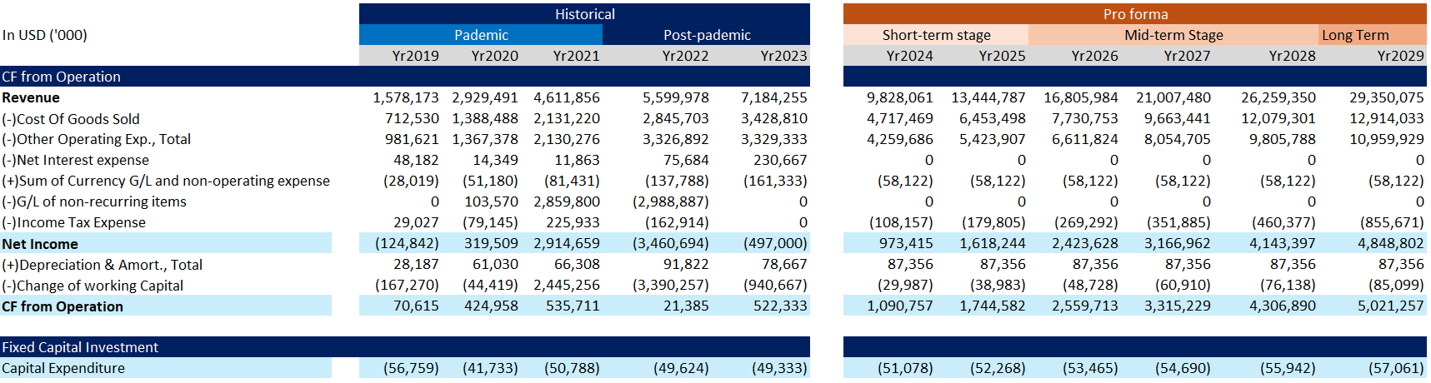
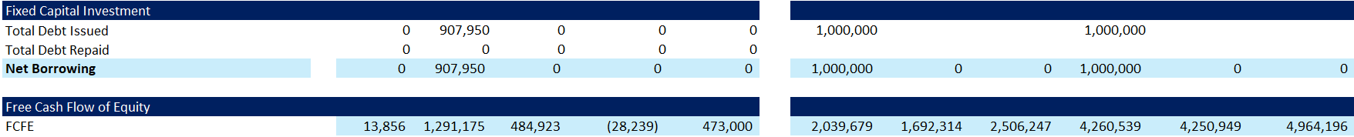
DCM Model

Slide 31
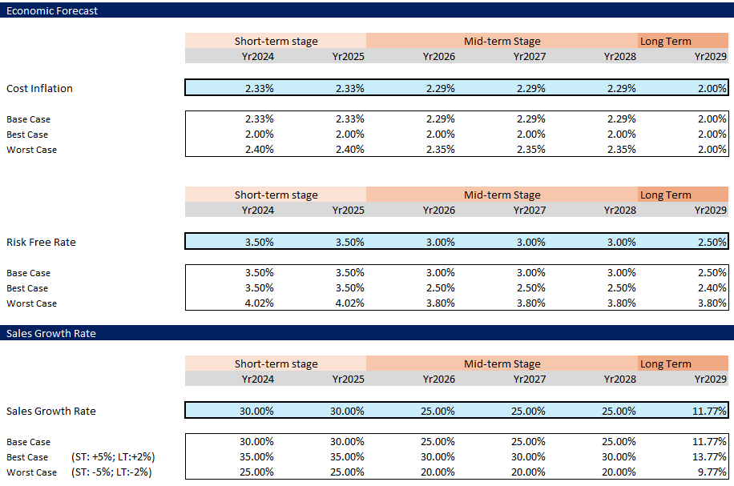
Scenario Analysis
Scenario | Projected Stock Price
Base | $64.43
Best | $171.08
Worst | $34.48
Current Stock Price | Projected Stock Price
Current | $76.36 (as of 1 Feb 24)

Slide 32
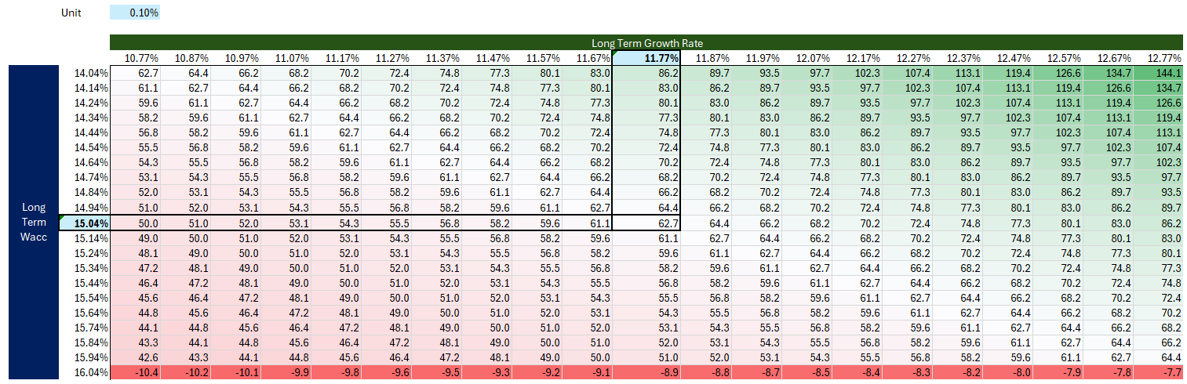
Sensitivity Testing
Given the projected cash flow,
To meet the current price, the difference between LT Wacc and LT growth rate shall be 2.47%,
where the existing spread is 3.27%

Slide 33
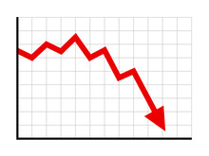
Conclusion and Recommendation
From our estimation, Shopify stock price is overvalued (Current price:$76.36 vs Predicted $64.43)
The potential factors lead to the discrepancy:-
Overestimated sales growth by the market
Volatile net income in short term
Market over optimistic expectation on the expense reduction
Under-estimated cost of capitals
Investor Concerns:-
Interest Rate/ Inflation sensitive: Consumers behaviour is sensitive to inflation/ interest rate (high Beta)
Future large CapEx deployment and potential raise of capital
Market share enhancement: GMV growth due to advancement of payment channel and brick and motor shops coverage
Recommendation
Sell or wait until the stock price correction arrives
Buy when interest rates starts to turn around and decrease

Slide 34

Thank you! Questions & Feedback

